Slide 1
INTRODUCTION TO COMPUTING
Course Code: CCINCOM/L
Q Learning
Elizer Ponio Jr.
Faculty Member
Department of Computer Science
College of Computing and Information Technologies (CCIT)
National University
Joseph Marvin R. Imperial
REINFORCEMENT LEARNING
NU College of Computing and Information Technologies
Course Code: CCRNFLRL

Slide 2
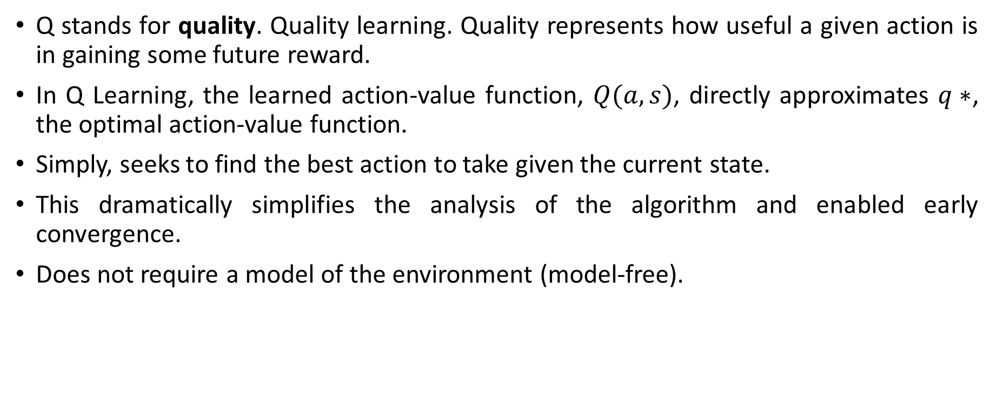
Q-Learning
INTRODUCTION TO COMPUTING
Course Code: CCINCOM/L
Q stands for quality. Quality learning. Quality represents how useful a given action is in gaining some future reward.
In Q Learning, the learned action-value function, $Q(a,s)$, directly approximates $q∗$, the optimal action-value function.
Simply, seeks to find the best action to take given the current state.
This dramatically simplifies the analysis of the algorithm and enabled early convergence.
Does not require a model of the environment (model-free).
Joseph Marvin R. Imperial
REINFORCEMENT LEARNING
NU College of Computing and Information Technologies
Course Code: CCRNFLRL

Slide 3
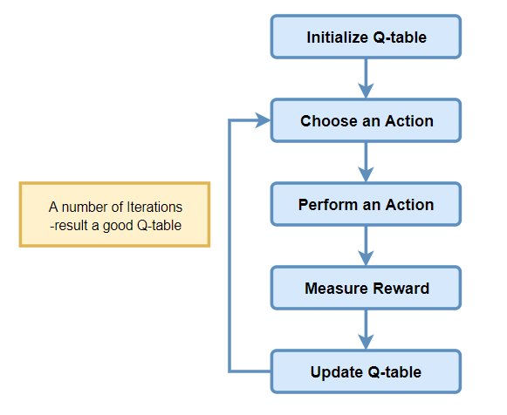
Q-Learning Flowchart
INTRODUCTION TO COMPUTING
Course Code: CCINCOM/L
Joseph Marvin R. Imperial
REINFORCEMENT LEARNING
NU College of Computing and Information Technologies
Course Code: CCRNFLRL

Slide 4
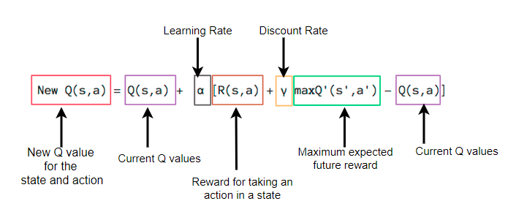
Q-Learning
INTRODUCTION TO COMPUTING
Course Code: CCINCOM/L
Joseph Marvin R. Imperial
REINFORCEMENT LEARNING
NU College of Computing and Information Technologies
Course Code: CCRNFLRL

Slide 5
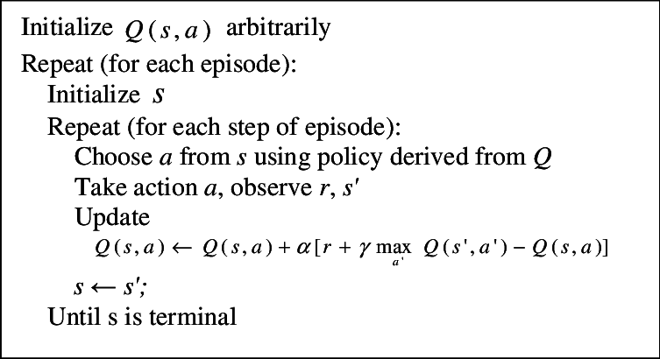
Q-Learning Algorithm
INTRODUCTION TO COMPUTING
Course Code: CCINCOM/L
Joseph Marvin R. Imperial
REINFORCEMENT LEARNING
NU College of Computing and Information Technologies
Course Code: CCRNFLRL

Slide 6
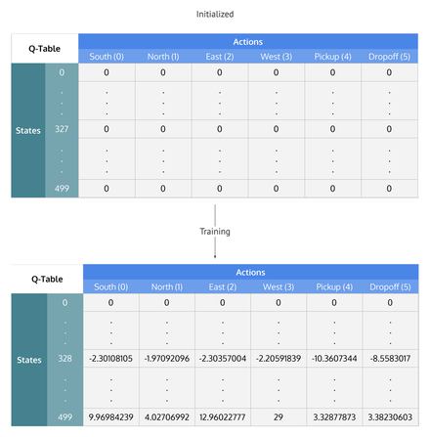
Q-Learning Training
INTRODUCTION TO COMPUTING
Course Code: CCINCOM/L
Q-Learning table of states by actions that is initialized to zero, then each cell is updated through training.
Joseph Marvin R. Imperial
REINFORCEMENT LEARNING
NU College of Computing and Information Technologies
Course Code: CCRNFLRL

Slide 7
Q-Learning Training
INTRODUCTION TO COMPUTING
Course Code: CCINCOM/L
Joseph Marvin R. Imperial
REINFORCEMENT LEARNING
NU College of Computing and Information Technologies
Course Code: CCRNFLRL

Slide 8
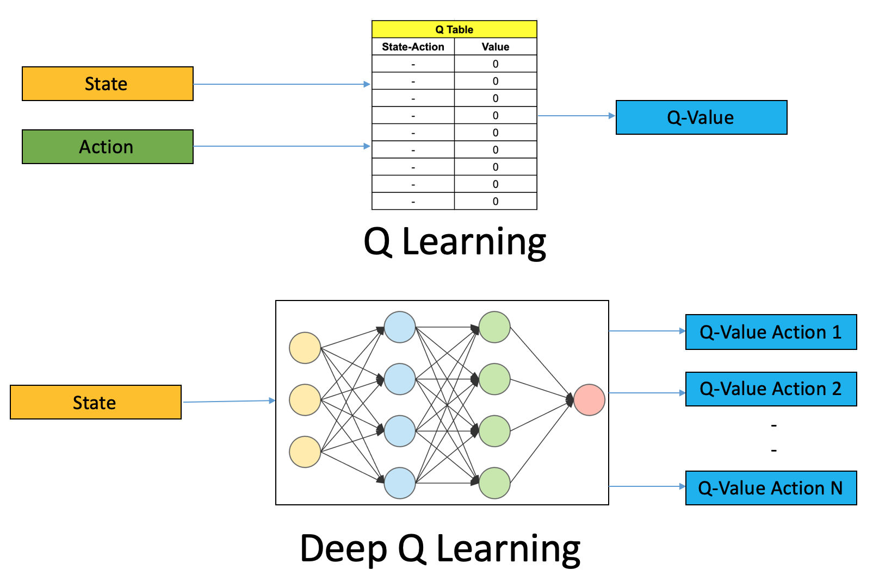
Q-Learning
INTRODUCTION TO COMPUTING
Course Code: CCINCOM/L
Joseph Marvin R. Imperial
REINFORCEMENT LEARNING
NU College of Computing and Information Technologies
Course Code: CCRNFLRL

Slide 9
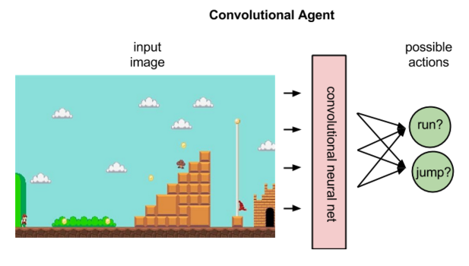
Q-Learning (Super Mario)
INTRODUCTION TO COMPUTING
Course Code: CCINCOM/L
Joseph Marvin R. Imperial
REINFORCEMENT LEARNING
NU College of Computing and Information Technologies
Course Code: CCRNFLRL

Slide 10
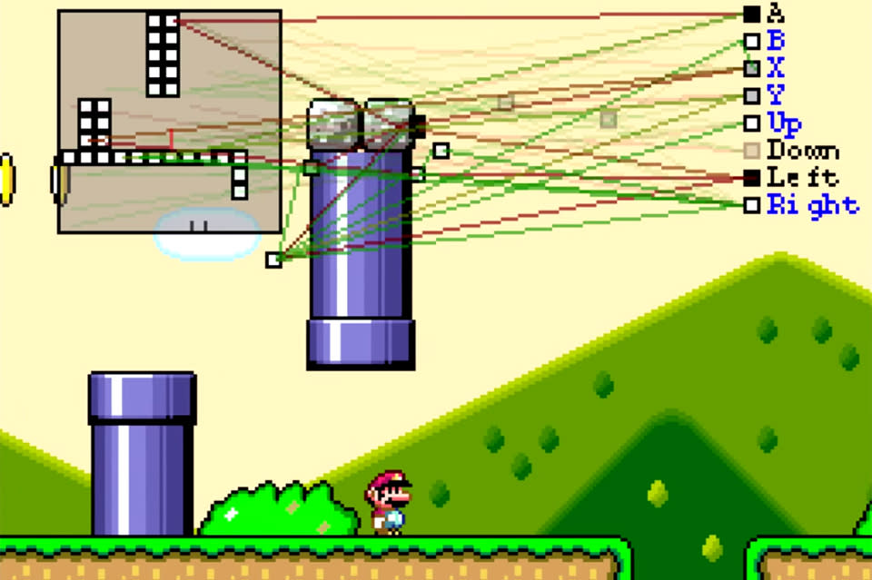
Q-Learning (Super Mario)
INTRODUCTION TO COMPUTING
Course Code: CCINCOM/L
Joseph Marvin R. Imperial
REINFORCEMENT LEARNING
NU College of Computing and Information Technologies
Course Code: CCRNFLRL

Slide 11
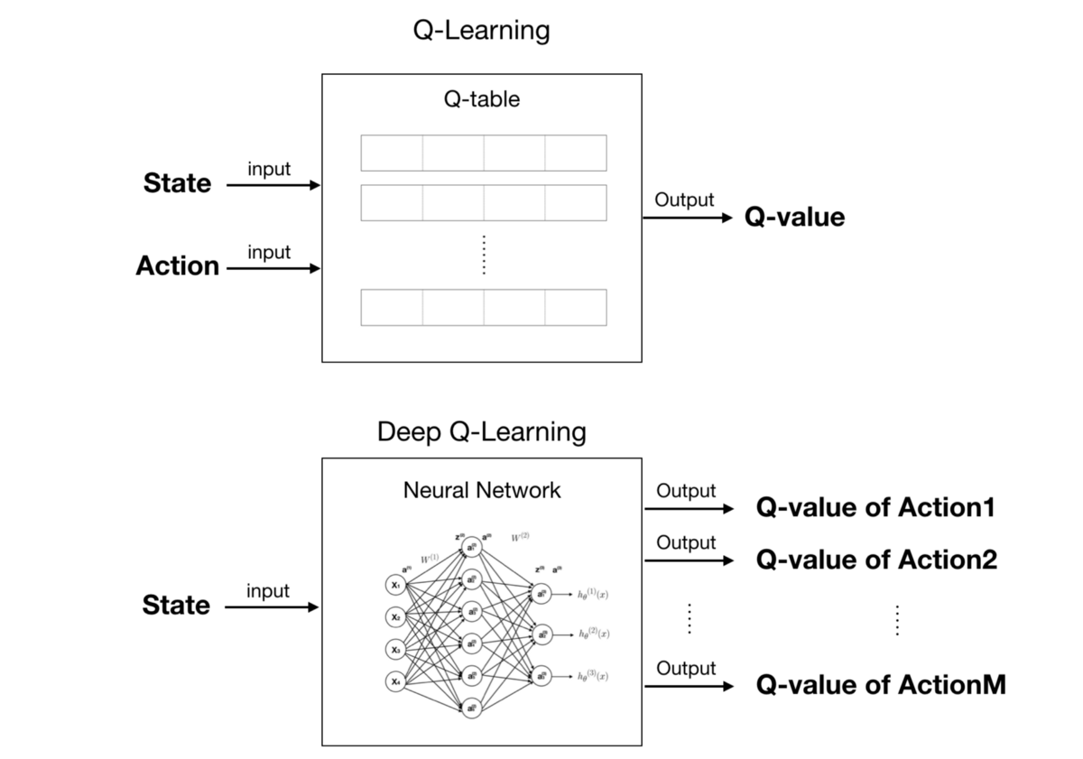
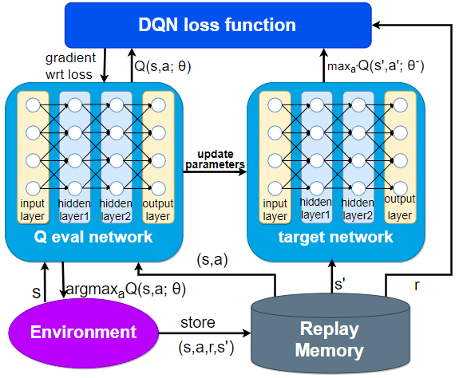
Deep Q Network
INTRODUCTION TO COMPUTING
Course Code: CCINCOM/L
Joseph Marvin R. Imperial
REINFORCEMENT LEARNING
NU College of Computing and Information Technologies
Course Code: CCRNFLRL

Slide 12
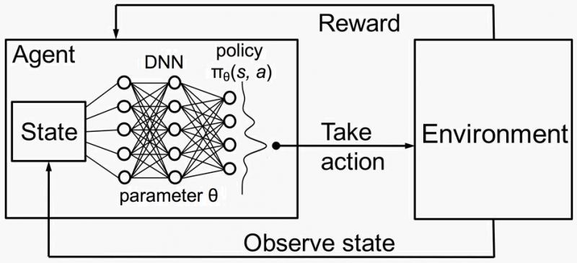
Deep Q Network
INTRODUCTION TO COMPUTING
Course Code: CCINCOM/L
Joseph Marvin R. Imperial
REINFORCEMENT LEARNING
NU College of Computing and Information Technologies
Course Code: CCRNFLRL

Slide 13
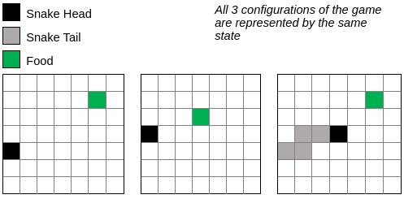
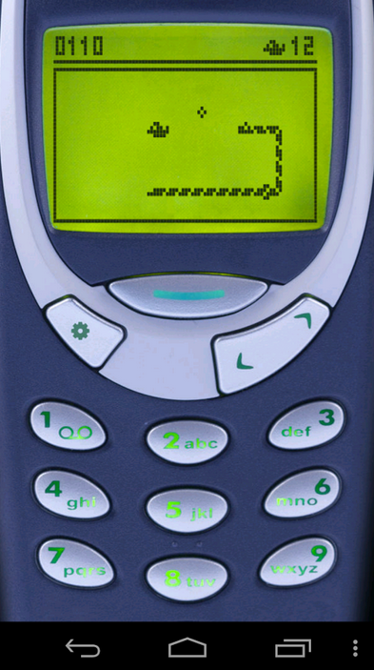
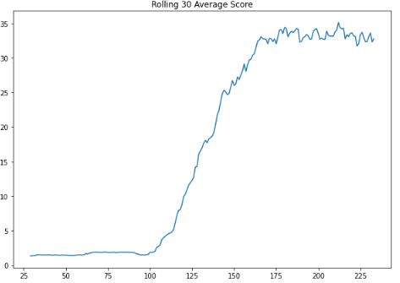
Q-Learning Demo
INTRODUCTION TO COMPUTING
Course Code: CCINCOM/L
Snake Game using Q-Learning
Joseph Marvin R. Imperial
REINFORCEMENT LEARNING
NU College of Computing and Information Technologies
Course Code: CCRNFLRL

Slide 14
References
INTRODUCTION TO COMPUTING
Course Code: CCINCOM/L
Images are licensed with Creative Commons. Can use without citing.
Prof. Emma Brunskill’s slides (CS234RL). https://web.stanford.edu/class/cs234/slides/lecture1.pdf
David Silver’s slides. https://www.davidsilver.uk/wp-content/uploads/2020/03/intro_RL.pdf
Review in Probability, Intro to RL Concepts
Joseph Marvin R. Imperial
REINFORCEMENT LEARNING
NU College of Computing and Information Technologies
Course Code: CCRNFLRL

